Slide 1
Are you happy?

Slide 2
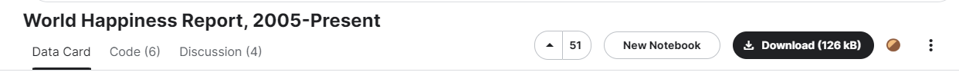
World Happiness Dataset
What defines “happiness” in a country:
GDP per capita
Healthy life expectancy
Social freedom
Social support
Generosity
Trust for government
Works Cited: Gallup World Poll

Slide 3
Objectives
Ranking Transition
Affecting factors
Influential nations
Suggestions

Slide 4
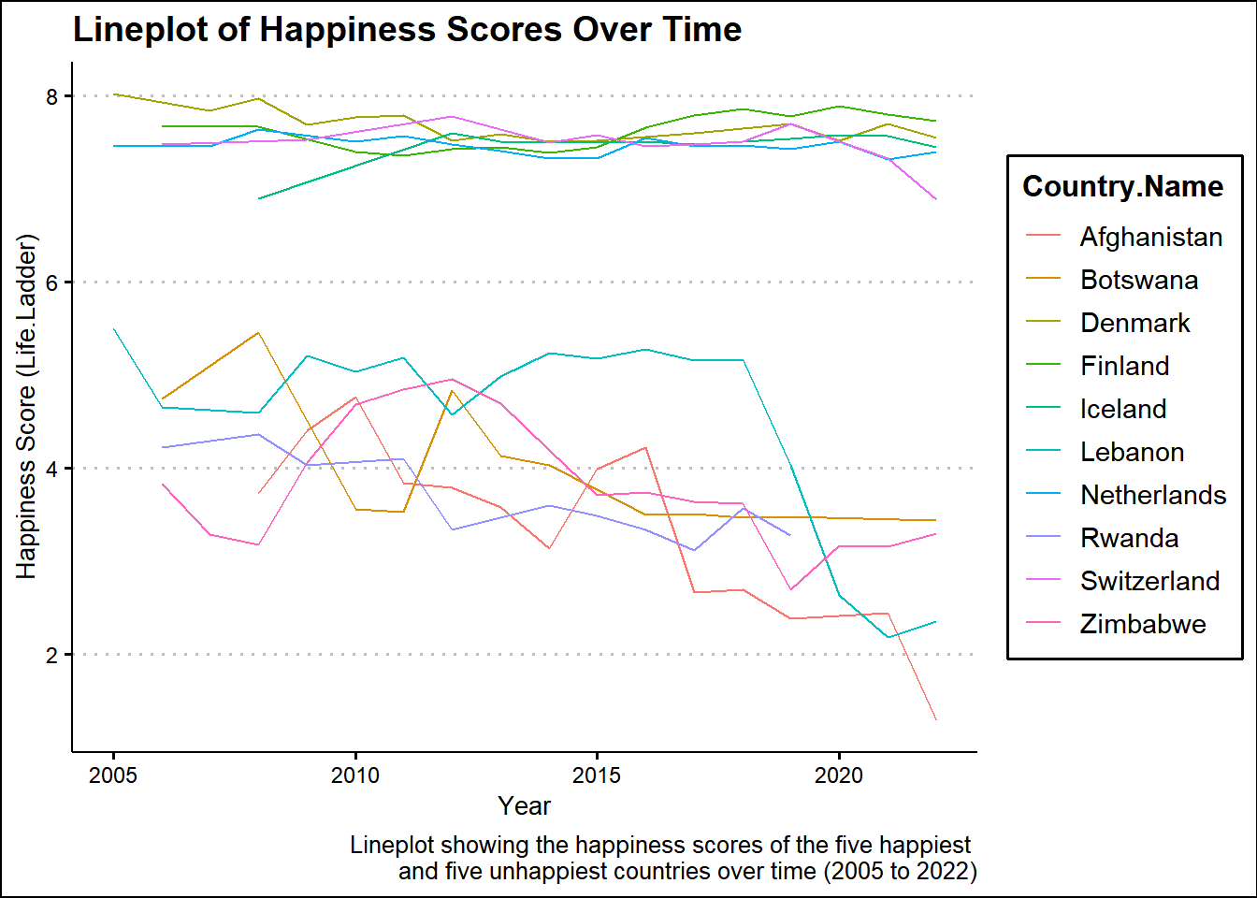
Ranking transition
Are the “happiest” countries really happy?

Slide 5


Slide 6

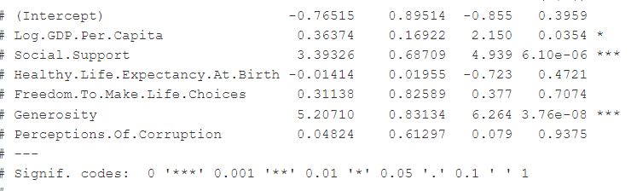

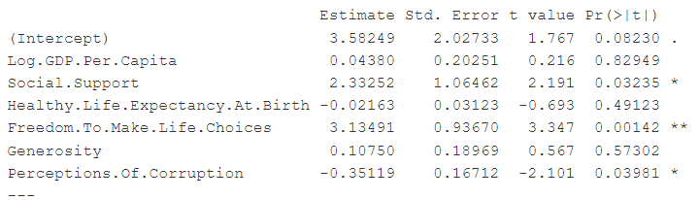
Factors that influence happiness level
Estimate t-value p-value
Estimate t-value p-value

Slide 7
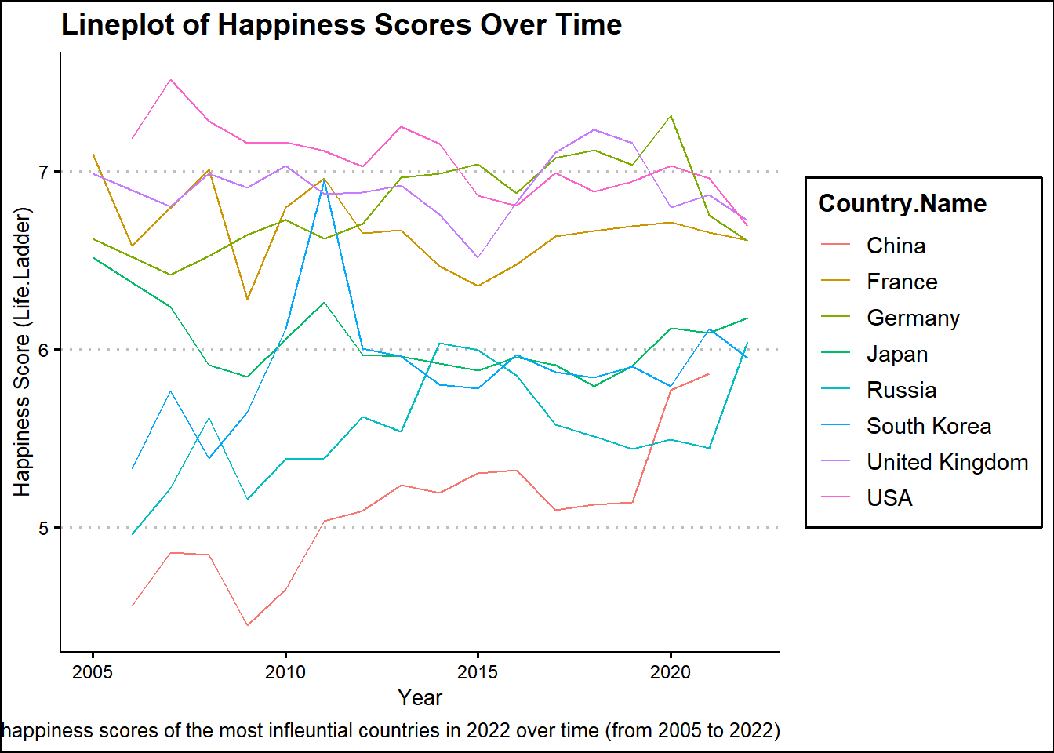
Happiness rate of most influential countries
China
South Korea
Russia
France
Germany
USA
Japan

Slide 8
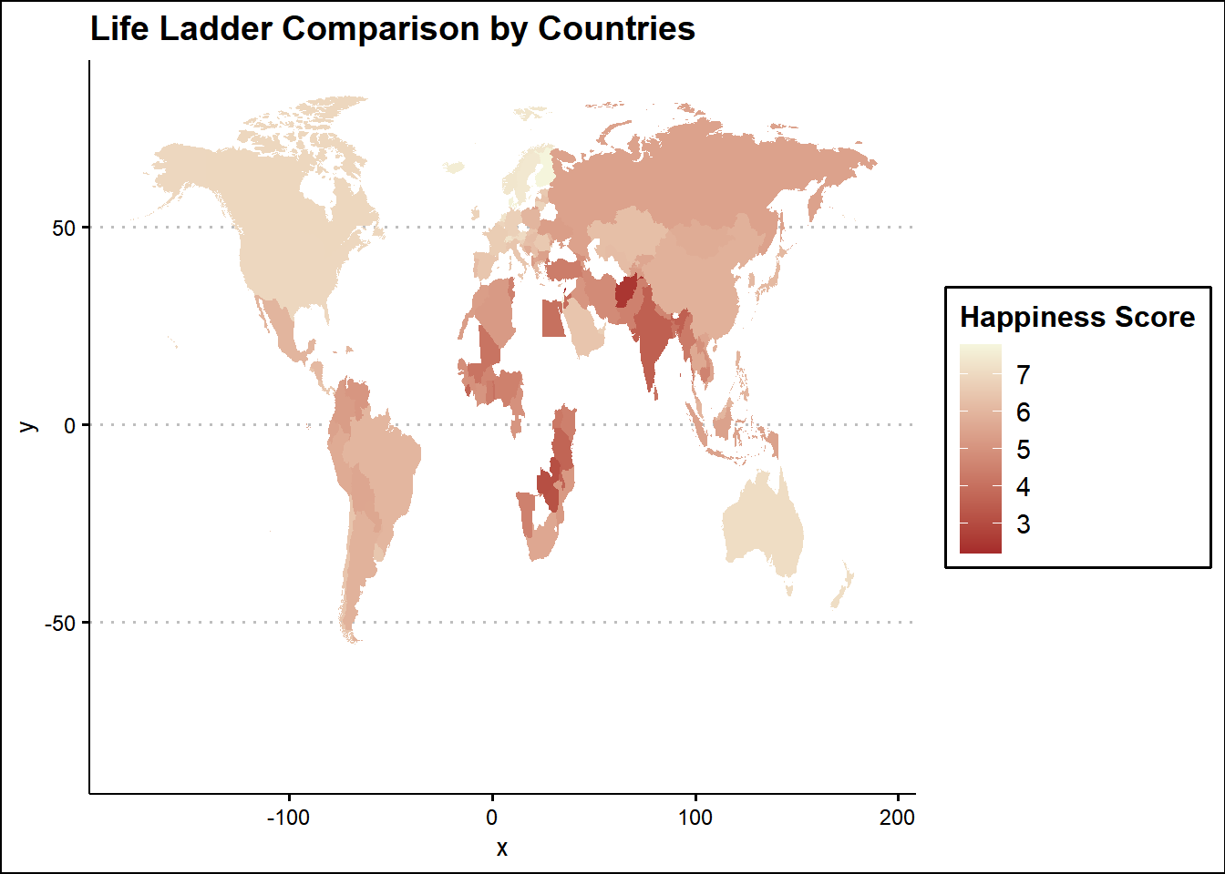
Map of Happiness for 2021
Several countries do not have 2021 data.
African countries have very low scores. Why?

Slide 9
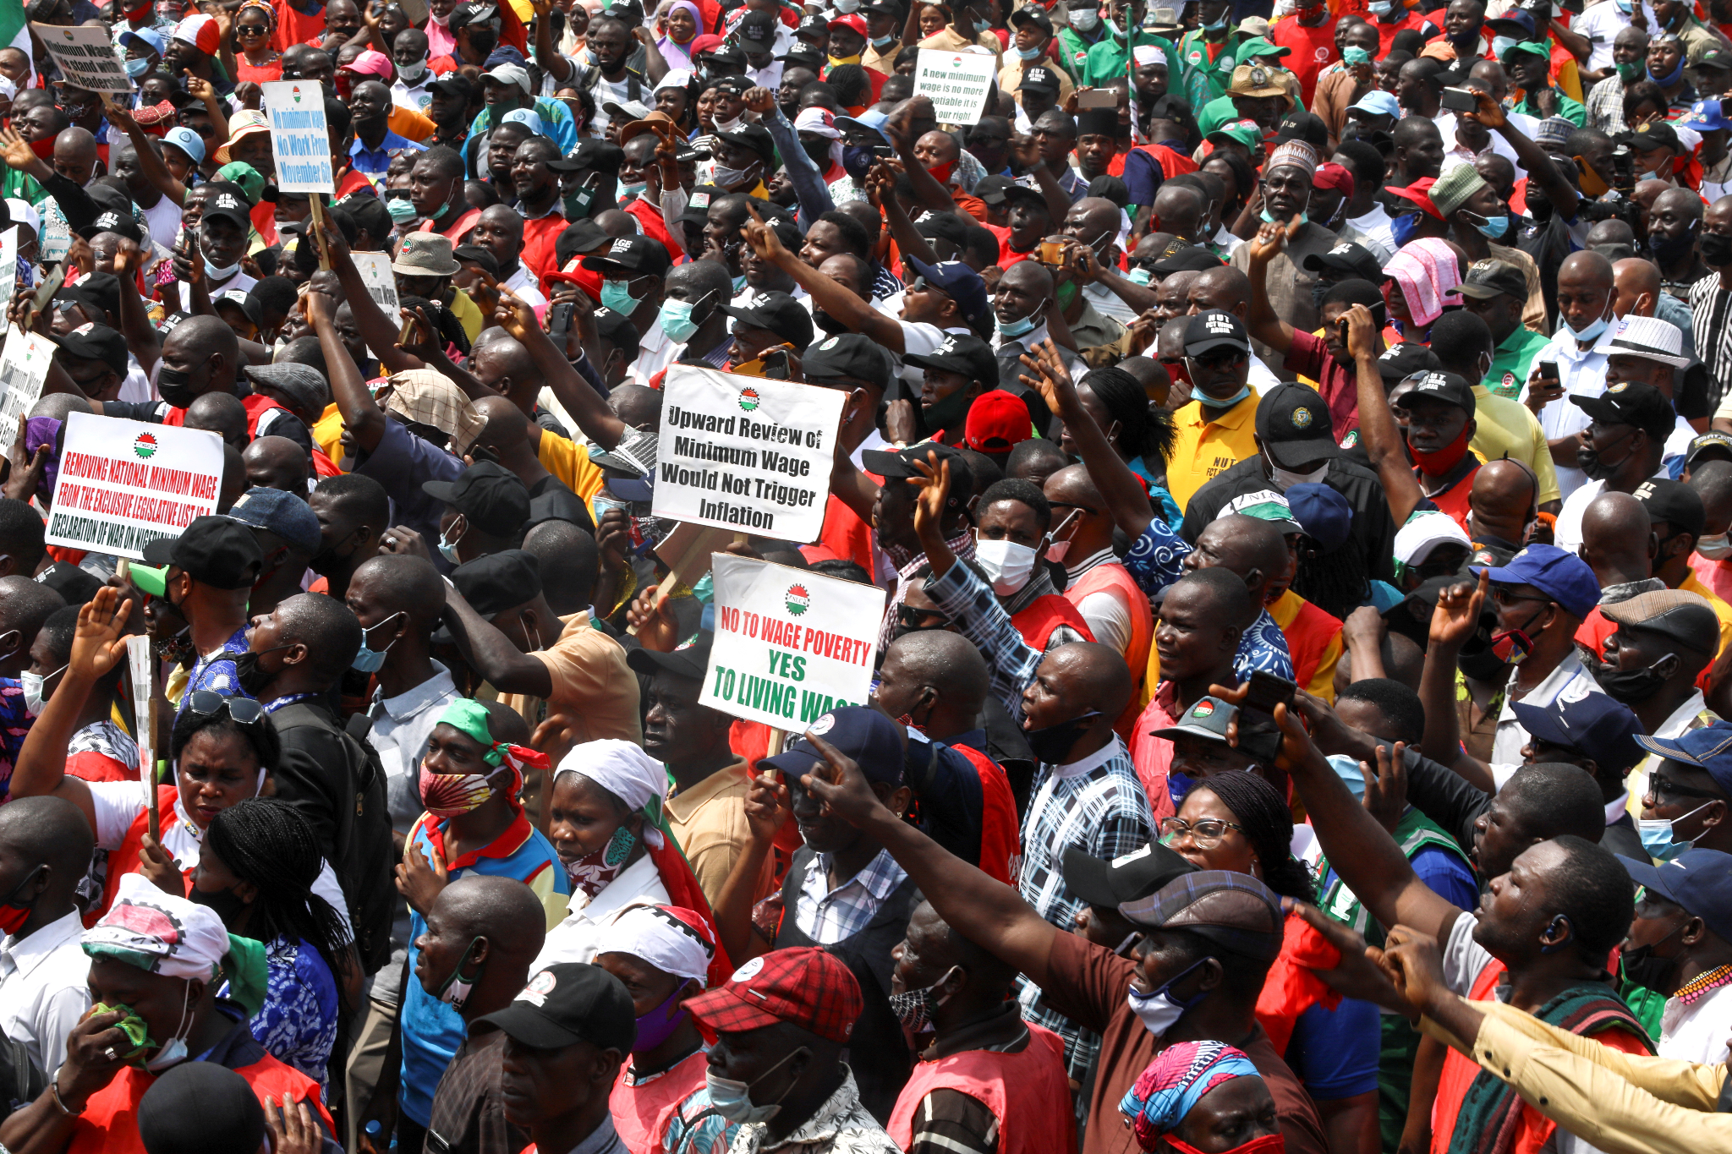
Why is Africa “sad”?
Dissatisfaction with democracy.
Continent with lowest GDP per capita, life expectancy, and has some of the most corrupt countries.
Works Cited:
Trueafrica.co
Brookings.edu
Notes:
Poverty and lack of access to basic needs.
Lack of infrastructure and not being able to keep up with growing population.
Historically underinvested in younger generation.

Slide 10
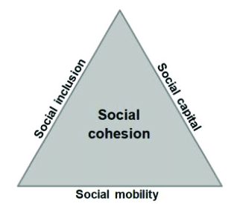
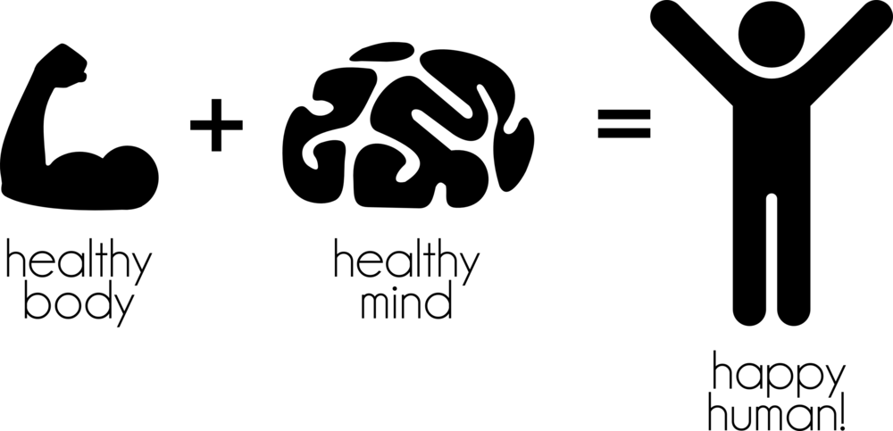
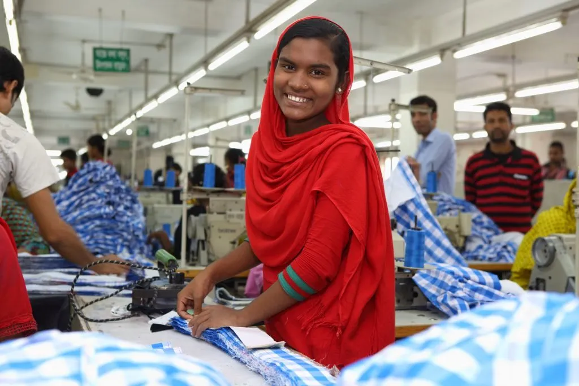
Conclusion & Suggestions
Socially support mental health + physical health
Provide decent working conditions + insurance
More efficient social cohesion
Works Cited: Brookings.edu

